Slide 1
Unit 1 - Semiconductors
Lecture 1

Slide 2
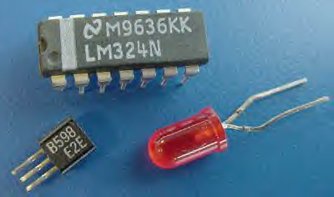
SEMICONDUCTORS

Slide 3

What is a Semiconductor?

Slide 4
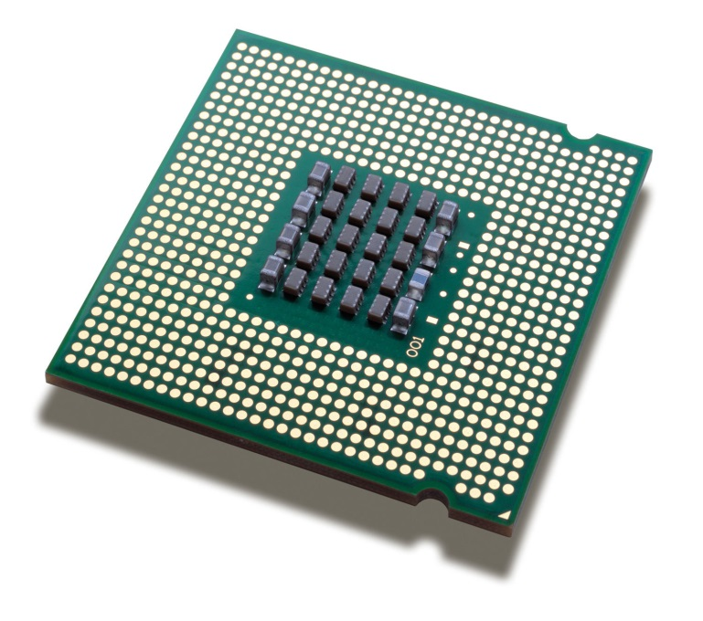
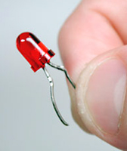
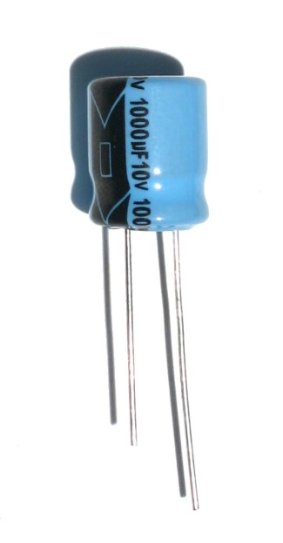
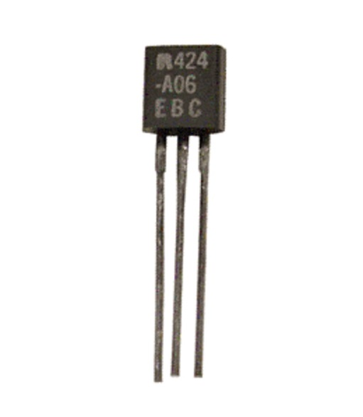
What is a Semiconductor?
Microprocessors
LED
Capacitors
Transistors

Slide 5
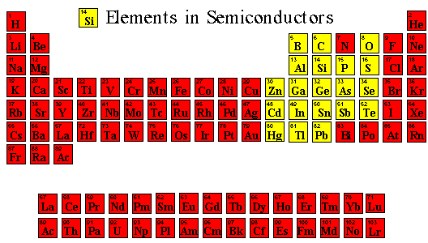

Slide 6
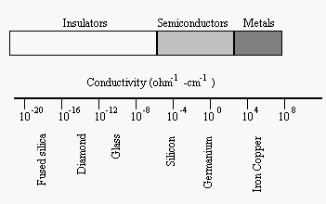
Range of Conductiveness
The semiconductors fall somewhere midway between conductors and insulators.

Slide 7
Range of Conductiveness
Semiconductors have special electronic properties which allow them to be insulating or conducting depending on their composition.

Slide 8
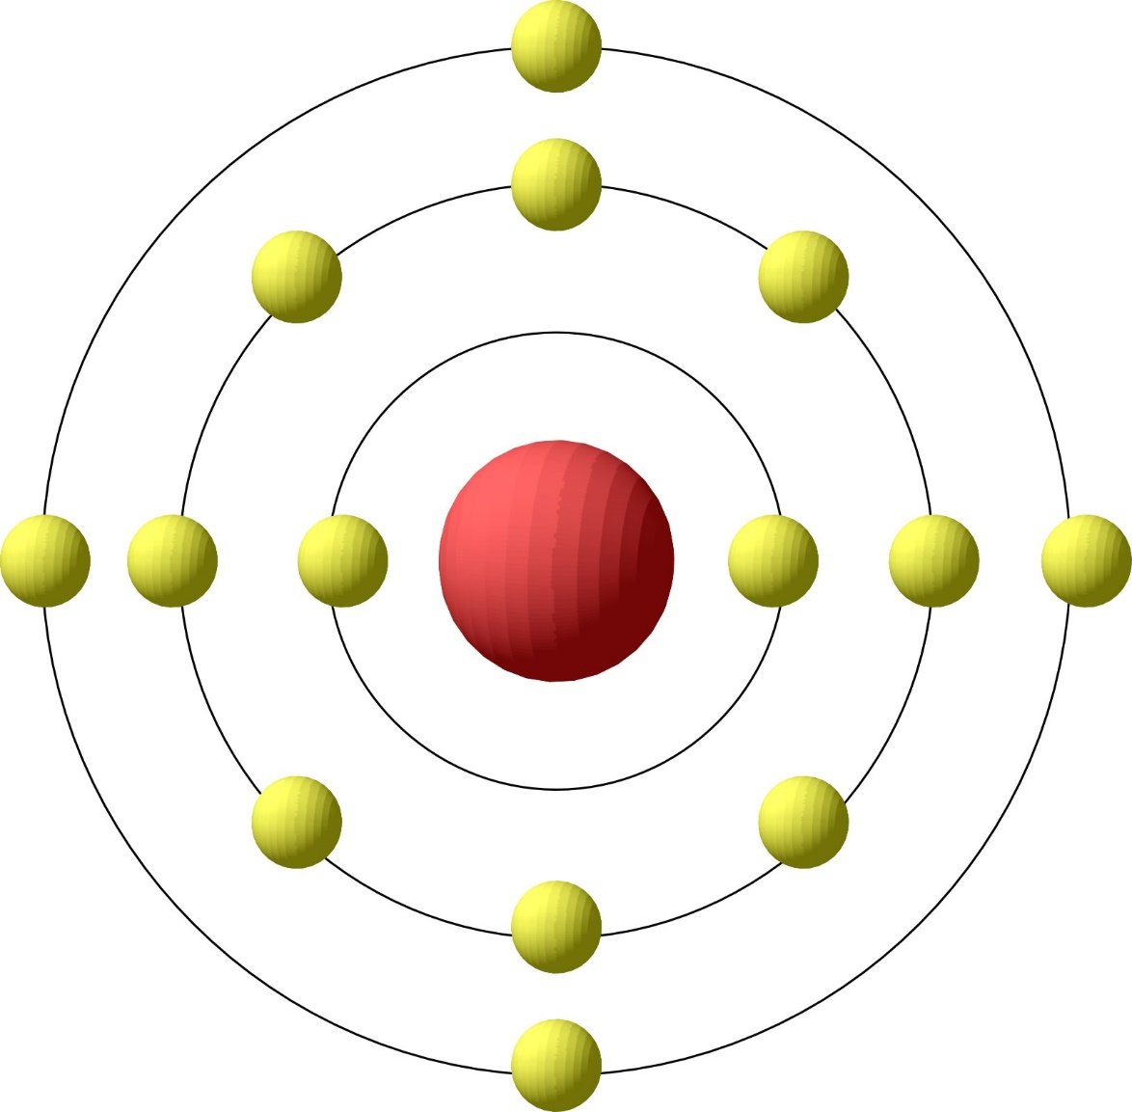
Silicon
Silicon is the primary semiconductor used in VLSI systems. Si has 14 Electrons
Energy Bands
(Shells)
Valence Band
Nucleus
At T=0K, the highest energy band occupied by an electron is called the valence band.
Silicon has 4 outer shell / valence electrons

Slide 9
Energy Bands
Electrons try to occupy the lowest energy band possible
Not every energy level is a legal state for an electron to occupy
These legal states tend to arrange themselves in bands
}
Disallowed Energy States
Increasing Electron Energy
Allowed Energy States
}
Energy Bands

Slide 10
Energy Bands
E_{C}
Conduction Band
First unfilled energy band at T=0K
E_{g}
Energy Bandgap
E_{V}
Valence Band
Last filled energy band at T=0K

Slide 11
Band Diagrams
E_{C}
Increasing electron energy
E_{g}
E_{V}
Increasing voltage
Band Diagram Representation
Energy plotted as a function of position
E_{C} → Conduction band
→ Lowest energy state for a free electron
E_{V} → Valence band
→ Highest energy state for filled outer shells
E_{G} → Band gap
→ Difference in energy levels between E_{C} and E_{V}
→ No electrons (e⁻) in the bandgap (only above E_{C} or below E_{V})
→ E_{G} = 1.12eV in Silicon

Slide 12
Insulators, Conductors, Semiconductors from energy band structures
E
E
E
Conduction band
empty
Almost empty
conduction band
-
Band
gap
electron
hole
Almost full
conduction band
Forbidden
region
Band
gap
E_{g} < 5eV
E_{g} > 5eV
+
Almost full valence band
Valence band
full
Insulator Semiconductor Conductor
Si: E_{g} = 1.1 eV
Ge: E_{g} = 0.75 eV
GaAs: E_{g} = 1.42 eV
SiO₂: E_{g} = 9 eV

Slide 13
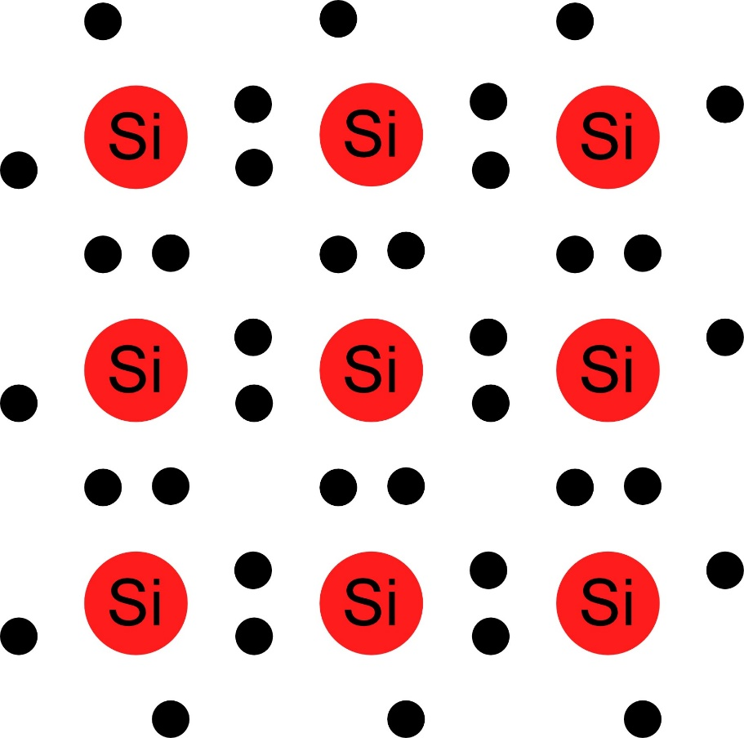
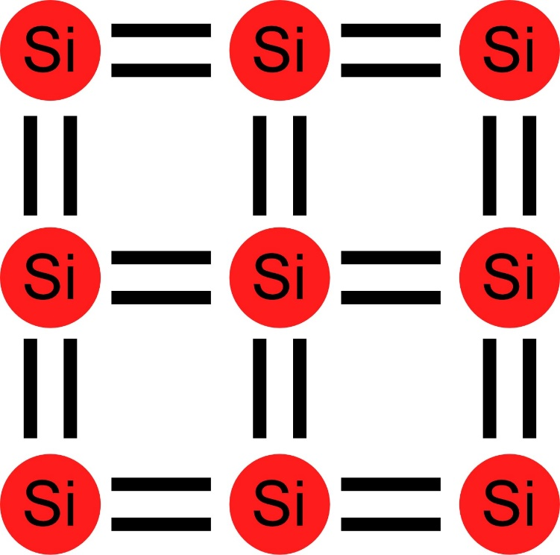
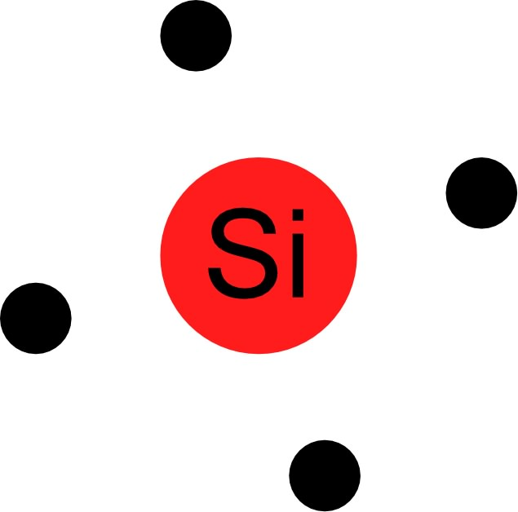
Intrinsic Semiconductor
Silicon has 4 outer shell / valence electrons
Forms into a lattice structure to share electrons

Slide 14
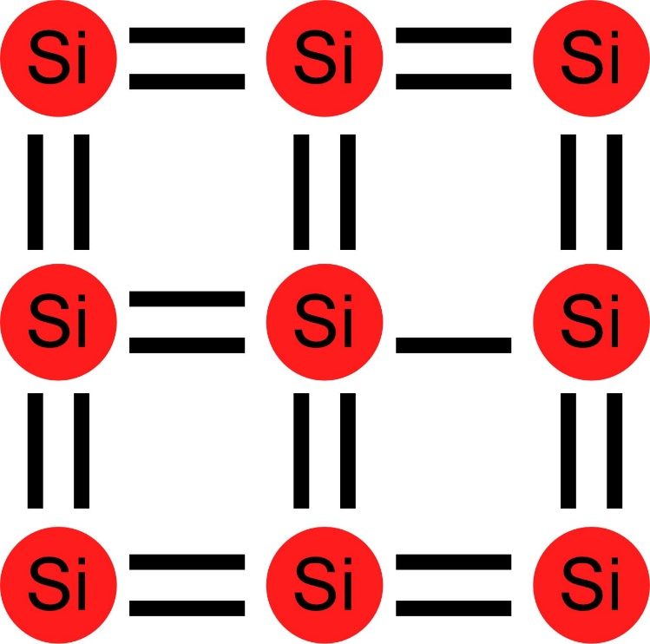
Intrinsic Silicon
The valence band is full, and no electrons are free to move about
E_{C}
E_{V}
However, at temperatures above T=0K, thermal energy shakes an electron free

Slide 15
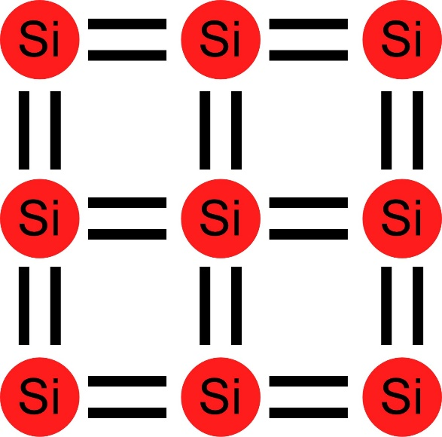
Semiconductor Properties
For T > 0K
Electron shaken free and can cause current to flow
Generation – Creation of an electron (e⁻) and hole (h⁺) pair
h⁺ is simply a missing electron, which leaves an excess positive charge (due to an extra proton)
Recombination – if an e⁻ and an h⁺ come in contact, they annihilate each other
Electrons and holes are called “carriers” because they are charged particles – when they move, they carry current
Therefore, semiconductors can conduct electricity for T > 0K … but not much current (at room temperature (300K), pure silicon has only 1 free electron per 3 trillion atoms)
h⁺
e–

Slide 16
Doping
Doping – Adding impurities to the silicon crystal lattice to increase the number of carriers
Add a small number of atoms to increase either the number of electrons or holes

Slide 17
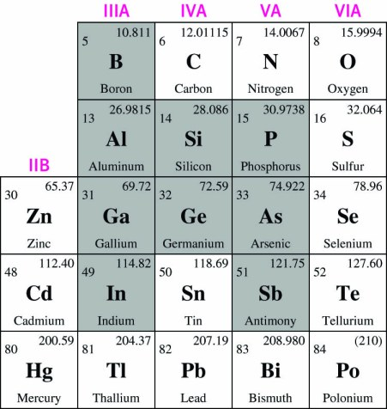
Periodic Table
Column 3 Elements have 3 electrons in the Valence Shell
Column 4 Elements have 4 electrons in the Valence Shell
Column 5 Elements have 5 electrons in the Valence Shell

Slide 18
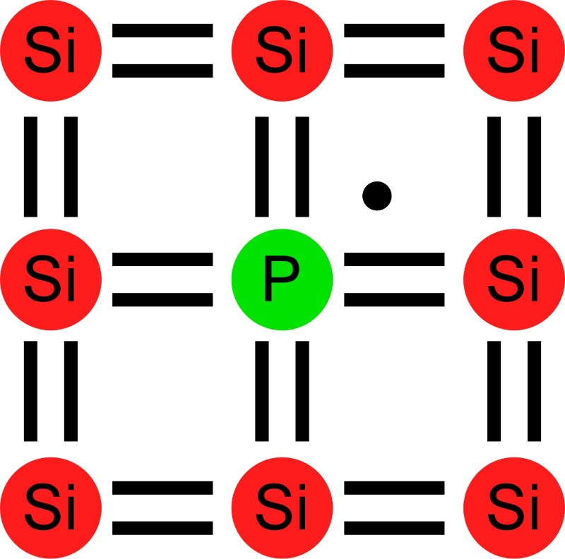
Donors n-Type Material
Donors
Add atoms with 5 valence-band electrons
ex. Phosphorous (P)
“Donates” an extra e⁻ that can freely travel around
Leaves behind a positively charged nucleus (cannot move)
Overall, the crystal is still electrically neutral
Called “n-type” material (added negative carriers)
N_{D} = the concentration of donor atoms [atoms/cm³ or cm⁻³]
~10¹⁵-10²⁰cm⁻³
e⁻ is free to move about the crystal (Mobility μ_{n} ≈1350cm²/V)
+

Slide 19
Donors n-Type Material
Donors
Add atoms with 5 valence-band electrons
ex. Phosphorous (P)
“Donates” an extra e⁻ that can freely travel around
Leaves behind a positively charged nucleus (cannot move)
Overall, the crystal is still electrically neutral
Called “n-type” material (added negative carriers)
N_{D} = the concentration of donor atoms [atoms/cm³ or cm⁻³]
~10¹⁵-10²⁰cm⁻³
e⁻ is free to move about the crystal (Mobility μ_{n} ≈1350cm²/V)
n-Type Material
–
–
–
–
+
+
–
+
+
+
+
+
+
–
–
–
+
–
+
–
+
+
+
–
–
–
–
+
+
+
+
+
–
–
+
–
Shorthand Notation
Positively charged ion; immobile
Negatively charged e-; mobile;
Called “majority carrier”
Positively charged h+; mobile;
Called “minority carrier”
+
–
+

Slide 20
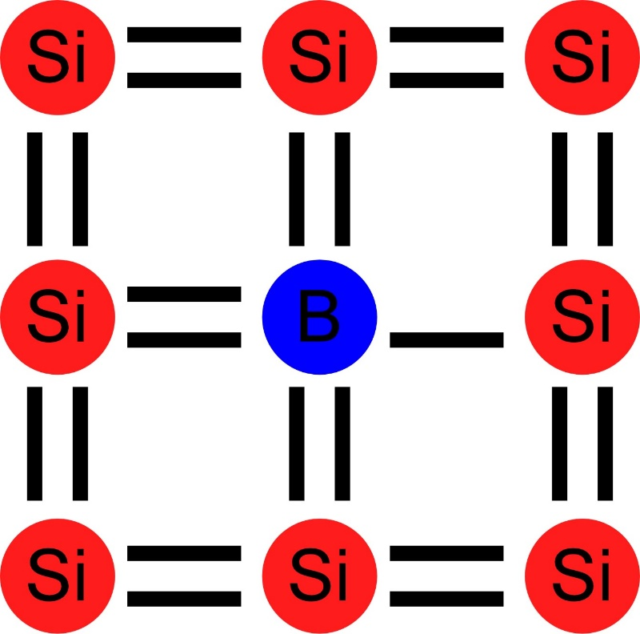
Acceptors Make p-Type Material
Acceptors
Add atoms with only 3 valence-band electrons
ex. Boron (B)
“Accepts” e– and provides extra h⁺ to freely travel around
Leaves behind a negatively charged nucleus (cannot move)
Overall, the crystal is still electrically neutral
Called “p-type” silicon (added positive carriers)
N_{A} = the concentration of acceptor atoms [atoms/cm³ or cm⁻³]
Movement of the hole requires breaking of a bond! (This is hard, so mobility is low, μ_{p} ≈ 500cm²/V)
h⁺
–
–

Slide 21
Acceptors Make p-Type Material
p-Type Material
Acceptors
Add atoms with only 3 valence-band electrons
ex. Boron (B)
“Accepts” e– and provides extra h⁺ to freely travel around
Leaves behind a negatively charged nucleus (cannot move)
Overall, the crystal is still electrically neutral
Called “p-type” silicon (added positive carriers)
N_{A} = the concentration of acceptor atoms [atoms/cm³ or cm⁻³]
Movement of the hole requires breaking of a bond! (This is hard, so mobility is low, μ_{p} ≈ 500cm²/V)
+
+
+
+
–
–
+
–
–
–
–
–
–
+
+
+
–
+
–
+
–
–
–
+
+
+
+
–
–
–
–
–
+
+
–
+
Shorthand Notation
Negatively charged ion; immobile
Positively charged h+; mobile;
Called “majority carrier”
Negatively charged e-; mobile;
Called “minority carrier”
–
+
–

Slide 22
The Fermi Function
The Fermi Function
Probability distribution function (PDF)
The probability that an available state at an energy E will be occupied by an e⁻
E → Energy level of interest
E_{f} → Fermi level
→ Halfway point
→ Where f(E) = 0.5
k → Boltzmann constant
= 1.38×10⁻²³ J/K
= 8.617×10⁻⁵ eV/K
T → Absolute temperature (in Kelvins)

Slide 23
Boltzmann Distribution
If
Then
Boltzmann Distribution
Describes exponential decrease in the density of particles in thermal equilibrium with a potential gradient
Applies to all physical systems
Atmosphere → Exponential distribution of gas molecules
Electronics → Exponential distribution of electrons
Biology → Exponential distribution of ions

Slide 24
Band Diagrams (Revisited)
E_{C}
E_{g}
E_{f}
E_{V}
Band Diagram Representation
Energy plotted as a function of position
E_{C} → Conduction band
→ Lowest energy state for a free electron
→ Electrons in the conduction band means current can flow
E_{V} → Valence band
→ Highest energy state for filled outer shells
→ Holes in the valence band means current can flow
E_{f} → Fermi Level
→ Shows the likely distribution of electrons
E_{G} → Band gap
→ Difference in energy levels between E_{C} and E_{V}
→ No electrons (e⁻) in the bandgap (only above E_{C} or below E_{V})
→ E_{G} = 1.12eV in Silicon
Virtually all of the valence-band energy levels are filled with e⁻
Virtually no e⁻ in the conduction band

Slide 25
Effect of Doping on Fermi Level
E_{f} is a function of the impurity-doping level
n-Type Material
E_{C}
E_{f}
E_{V}
High probability of a free e⁻ in the conduction band
Moving E_{f} closer to E_{C} (higher doping) increases the number of available majority carriers

Slide 26
Effect of Doping on Fermi Level
E_{f} is a function of the impurity-doping level
p-Type Material
E_{C}
E_{f}
E_{V}
Low probability of a free e⁻ in the conduction band
High probability of h⁺ in the valence band
Moving E_{f} closer to E_{V} (higher doping) increases the number of available majority carriers

Slide 27
Equilibrium Carrier Concentrations
n = # of e⁻ in a material
p = # of h⁺ in a material
n_{i} = # of e⁻ in an intrinsic (undoped) material
Intrinsic silicon
Undoped silicon
Fermi level
Halfway between E_{v} and E_{c}
Location at “E_{i}”
E_{C}
E_{g}
E_{f}
E_{V}

Slide 28
Equilibrium Carrier Concentrations
Non-degenerate Silicon
Silicon that is not too heavily doped
E_{f} not too close to E_{v} or E_{c}
Assuming non-degenerate silicon
Multiplying together

Slide 29
Charge Neutrality Relationship
For uniformly doped semiconductor
Assuming total ionization of dopant atoms
# of carriers
# of ions
Total Charge = 0
Electrically Neutral

Slide 30
Calculating Carrier Concentrations
Based upon “fixed” quantities
N_{A}, N_{D}, n_{i} are fixed (given specific dopings for a material)
n, p can change (but we can find their equilibrium values)

Slide 31
Common Special Cases in Silicon
Intrinsic semiconductor (N_{A} = 0, N_{D} = 0)
Heavily one-sided doping
Symmetric doping

Slide 32
Intrinsic Semiconductor (N_{A}=0, N_{D}=0)
Carrier concentrations are given by

Slide 33
Heavily One-Sided Doping
This is the typical case for most semiconductor applications
If
(Nondegenerate, Total Ionization)
Then
If
(Nondegenerate, Total Ionization)
Then

Slide 34
Symmetric Doping
Doped semiconductor where n_{i} >> |N_{D}-N_{A}|
Increasing temperature increases the number of intrinsic carriers
All semiconductors become intrinsic at sufficiently high temperatures

Slide 35
Determination of E_{f} in Doped Semiconductor
Also, for typical semiconductors (heavily one-sided doping)
[units eV]

Slide 36
Thermal Motion of Charged Particles
Look at drift and diffusion in silicon
Assume 1-D motion
Applies to both electronic systems and biological systems

Slide 37
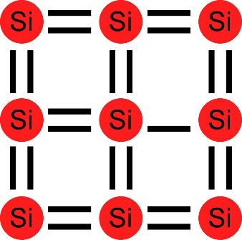
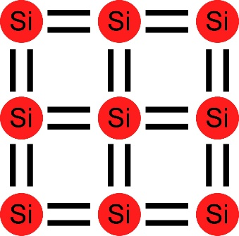
Drift
Drift → Movement of charged particles in response to an external field (typically an electric field)
E-field applies force
F = qE
which accelerates the charged particle.
However, the particle does not accelerate indefinitely because of collisions with the lattice (velocity saturation)
Average velocity
<v_{x}> ≈ -µ_{n}E_{x} electrons
< v_{x} > ≈ µ_{p}E_{x} holes
µ_{n} → electron mobility
→ empirical proportionality constant between E and velocity
µ_{p} → hole mobility
µ_{n} ≈ 3µ_{p} µ↓ as T↑
E

Slide 38
Drift
Drift → Movement of charged particles in response to an external field (typically an electric field)
E-field applies force
F = qE
which accelerates the charged particle.
However, the particle does not accelerate indefinitely because of collisions with the lattice (velocity saturation)
Average velocity
<v_{x}> ≈ -µ_{n}E_{x} electrons
< v_{x} > ≈ µ_{p}E_{x} holes
µ_{n} → electron mobility
→ empirical proportionality constant between E and velocity
µ_{p} → hole mobility
µ_{n} ≈ 3µ_{p} µ↓ as T↑
Current Density
q = 1.6×10⁻¹⁹ C, carrier density
n = number of e⁻
p = number of h⁺

Slide 39
Resistivity
Closely related to carrier drift
Proportionality constant between electric field and the total particle current flow
n-Type Semiconductor
p-Type Semiconductor
Therefore, all semiconductor material is a resistor
Could be parasitic (unwanted)
Could be intentional (with proper doping)
Typically, p-type material is more resistive than n-type material for a given amount of doping
Doping levels are often calculated/verified from resistivity measurements

Slide 40
Diffusion
Diffusion → Motion of charged particles due to a concentration gradient
Charged particles move in random directions
Charged particles tend to move from areas of high concentration to areas of low concentration (entropy – Second Law of Thermodynamics)
Net effect is a current flow (carriers moving from areas of high concentration to areas of low concentration)
q = 1.6×10⁻¹⁹ C, carrier density
D = Diffusion coefficient
n(x) = e⁻ density at position x
p(x) = h⁺ density at position x
→ The negative sign in J_{p,diff} is due to moving in the opposite direction from the concentration gradient
→ The positive sign from J_{n,diff} is because the negative from the e⁻ cancels out the negative from the concentration gradient

Slide 41
Total Current Densities
Summation of both drift and diffusion
(1 Dimension)
(3 Dimensions)
(1 Dimension)
(3 Dimensions)
Total current flow

Slide 42
Einstein Relation
Einstein Relation → Relates D and µ (they are not independent of each other)
U_{T} = kT/q
→ Thermal voltage
= 25.86mV at room temperature
≈ 26mV for quick hand approximations
→ Used in biological and silicon applications

Slide 43
Changes in Carrier Numbers
Primary “other” causes for changes in carrier concentration
Photogeneration (light shining on semiconductor)
Recombination-generation
Photogeneration
Photogeneration rate
Creates same # of e⁻ and h⁺

Slide 44
Changes in Carrier Numbers
Indirect Thermal Recombination-Generation
n₀, p₀ → equilibrium carrier concentrations
n, p → carrier concentrations under arbitrary conditions
Δn, Δp → change in # of e⁻ or h⁺ from equilibrium conditions
h⁺ in n-type material
e⁻ in p-type material
Assumes low-level injection

Slide 45
Minority Carrier Properties
Minority Carriers
e⁻ in p-type material
h⁺ in n-type material
Minority Carrier Lifetimes
τ_{n} → The time before minority carrier electrons undergo recombination in p-type material
τ_{p} → The time before minority carrier holes undergo recombination in n-type material
Diffusion Lengths
How far minority carriers will make it into “enemy territory” if they are injected into that material
for minority carrier e⁻ in p-type material
for minority carrier h⁺ in n-type material

